Slide 1
NAMASKAR
From
NEPAL ARADHANA SAMAJ
(KARUNA BHAWAN)
Annual Progress
FY 2069-070 B.S. (2012-13 A.D.)

Slide 2
Nepal Aradhana Samaj is working in health, and education sectors. It aims at providing services to empower HIV infected women and to ensure easy access to health facilities for HIV infected people and quality education for marginalized and disadvantaged children. Currently it is working in Lalitpur, Parsa and Bara District of Nepal.
It is our great pleasure that Nepal Aradhana Samaj has travelled a long journey with successful achievements of set goals to enter its 15th year.

Slide 3
Vision, Mission and Objectives
Vision
Nepal Adoration Society envisages a healthy, educated and economically sound society.
Mission
The mission of Nepal Adoration Society is Economic, Social, Educational and Cultural empowerment of women, disadvantaged children, indigenous groups and other suppressed people.
Objectives
To provide health services to disadvantaged and marginalized groups.
To provide care and support to sick and needy people.
Empowering disadvantaged children through quality education.
To enhance the awareness among illiterate and economically backward groups through formal and informal education.
To make poor people and disadvantaged children self-dependent and skilled through technical and vocational trainings.

Slide 4
Program Interventions
Health
Education
Health
Health program activities are aimed at improving physical and mental health status through easy access to treatment, care and support for HIV infected people, raising awareness about HIV/AIDS in community, building confidence and self dependency among target population through various skill trainings. NAS has formulated three strategic program components under health program for HIV infected people. These are being implemented in Lalitpur, Parsa and Bara districts.
Strategic components:
Care and Support
Community sensitization
Capacity building and skill development

Slide 5
Program Interventions ……….
Education
Education program activities are aimed at over all development of vulnerable and marginalized children through easy access to quality education, secure and amicable environment, and Skill and leadership trainings for personality development. NAS has formulated three strategic program components under the education program for vulnerable, HIV infected, and marginalized children. These are being implemented in Lalitpur, Parsa and Bara districts.
Strategic components:
Residential support for vulnerable girls
School fee and educational material support
Personality development through various skill trainings

Slide 6
Projects
S.N. | Project | Location
1 | Care and Support for HIV infected Women and Children | Godavari, Lalitpur
2 | Care and Support for HIV infected people | Birgunj, Parsa
3 | Karuna Education Support | Nakkhu, Lalitpur
4 | Karuna Kinderhaus (Hostel for marginalized and disadvantaged girls) | Godavari, Lalitpur

Slide 7
Care and Support for HIV infected Women and Children, Godavari
Nepal Aradhana Samaj, in partnership with Kindermissionswerk Germany, has been providing rehabilitation with treatment, education, and skill training services to those HIV infected women and children from different corners of Nepal who are forced to leave home by family members and society and living at bay without a proper support mechanism.
Project objectives:
Providing shelter, food and medical treatment to HIV infected women and children.
Empowering HIV infected women through skill trainings and employment opportunity.
Providing education opportunity to infected children.

Slide 8
Care and Support for HIV infected Women and Children, Godavari ………………
Project Activities:
Running rehab centre to provide shelter and food to in-housed clients.
Treatment and other essential medical services.
Education support to in-housed infected children.
Income generating activities.
Skill training.

Slide 9
Care and Support for HIV infected Women and Children, Godavari ………………
Achievements:
28 (6 women and 22 children) in-housed clients received living support, treatment, nursing care.
20 children received education support.
All 6 in-housed women engaged in income generating activities and skill training.
All inmates received awareness on different psycho-social aspects to strengthen morale.
1 of inmates joined another NGO with a determination of serving HIV infected people.
100% class promotion by in-housed children.

Slide 10
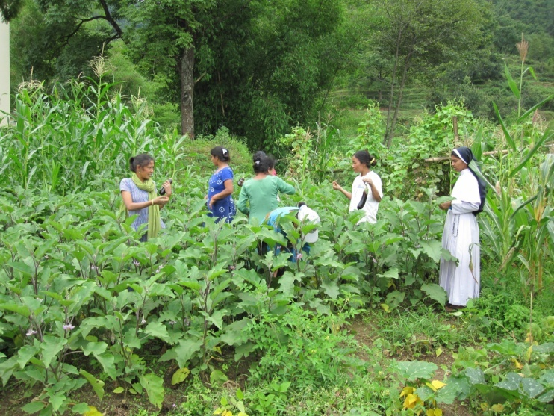
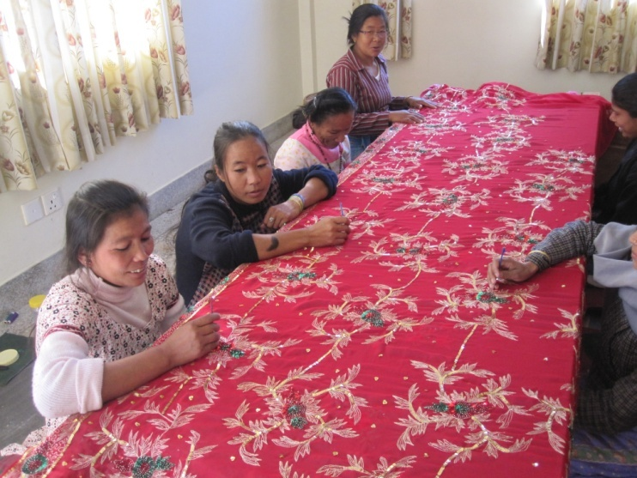
Care and Support for HIV infected Women and Children, Godavari ………………
Income generating Activities:
In the year 2012-13 women inmates utilized their skills in income generating activities like knitting, candle making and embroidering. They used to sell their product in local market.
Goat and rabbit raising was also done by them as a source of income. Further, they engaged themselves in vegetable gardening that meets the day to day vegetable needs of Karuna Bhawan to a great extent.

Slide 11
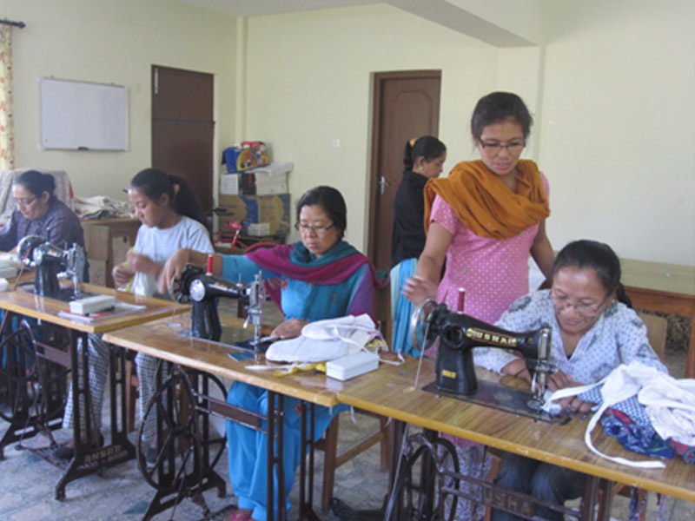
Care and Support for HIV infected Women and Children, Godavari ………………
Skill Training
Karuna Bhawan, Godavari is focusing more in strengthening HIV infected women by providing various skill trainings. This year tailoring training has been started with generous support of Miss Mary L Partosa.

Slide 12
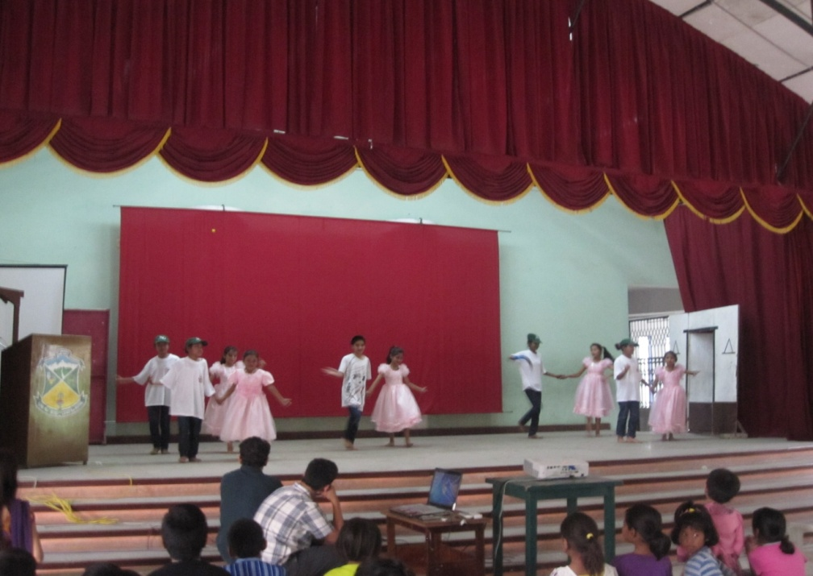
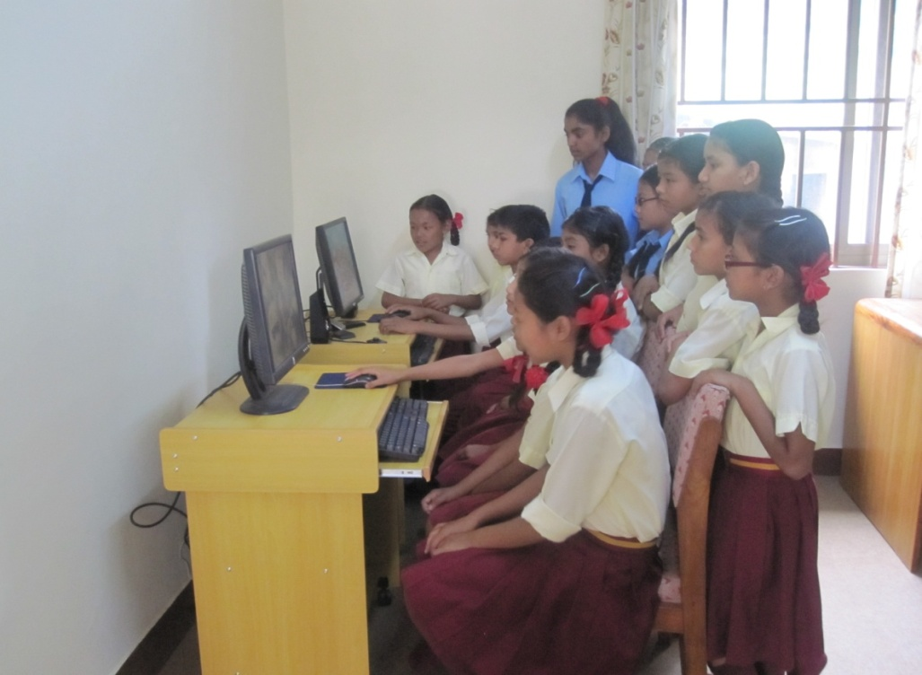
Care and Support for HIV infected Women and Children, Godavari ………………
Personality development:
In-housed children actively took part in cultural programs and other skill development trainings like computer, music etc.
Cultural program was held at Isalaya church Parish hall Godavary
Computer Training

Slide 13
Care and Support for HIV infected People, Birgunj
Nepal Aradhana Samaj is running a project for providing Care and support to HIV infected people with generous support of MISEREOR, Germany in Parsa and adjoining districts.
Project Objectives:
Providing appropriate care to PLHA
Creating appropriate environment for the welfare of PLHA.
Enhancing the knowledge and capacity of PLHA.
Playing important role in the community to reduce HIV infection.
Enhancing the awareness on HIV/AIDS by Dissemination of truth and correct information in the community.
Providing education support to disadvantaged and marginalized HIV infected children

Slide 14
Care and Support for HIV infected People, Birgunj…………
Activities:
Care home services.
Medical treatment and other essential health services.
Psycho-social counseling
Home visit
Awareness programs on HIV/AIDS
Education Support
Capacity Development of PLHA

Slide 15
Care and Support for HIV infected People, Birgunj…………
Achievements:
141 HIV infected people received living support at care home.
168 HIV infected people received Psycho-social counselling.
224 HIV infected people received treatment for opportunistic infection.
184 HIV infected people referred for CD4 test
37 HIV infected people put on Anti Retroviral Therapy
20 infected and affected children received education support.
2173 people sensitized on HIV/AIDS in communities.
211 people underwent Voluntary Counselling and Testing (VCT)
31 HIV infected people received CHBC training.
353 pregnant woman received PMTC counselling.
5 HIV infected people mobilized as peer educator.

Slide 16
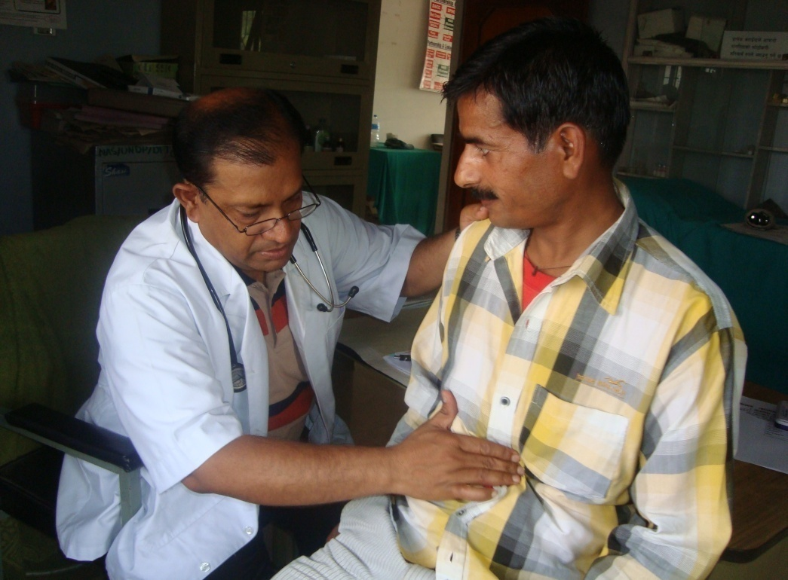
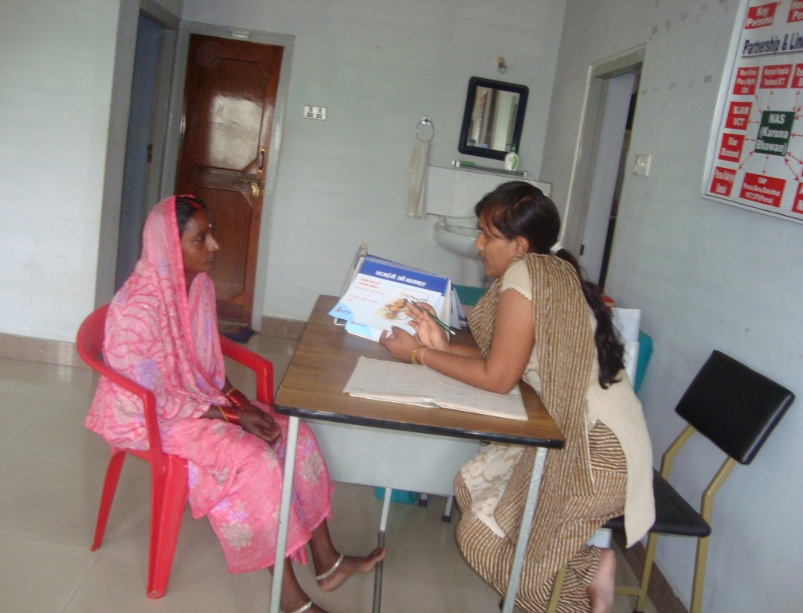
Care and Support for HIV infected People, Birgunj…………
Care home and treatment:
HIV infected people who suffer from illness or psychological stress come to care home for support and treatment. Stay can be from one day to 21 days as per need. During their stay they receive living support.
Medical checkup at care home
Psychological counseling

Slide 17
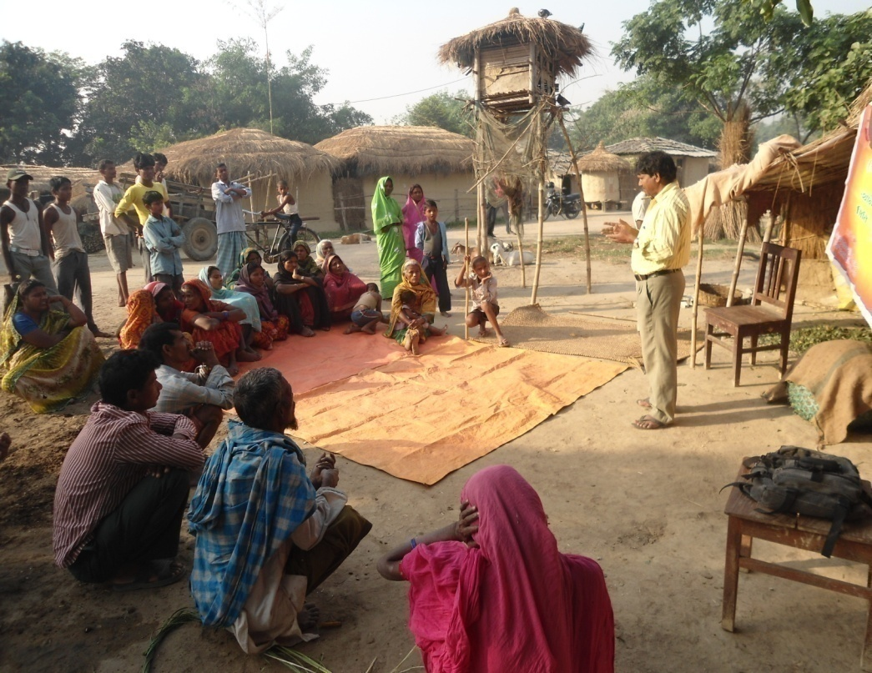
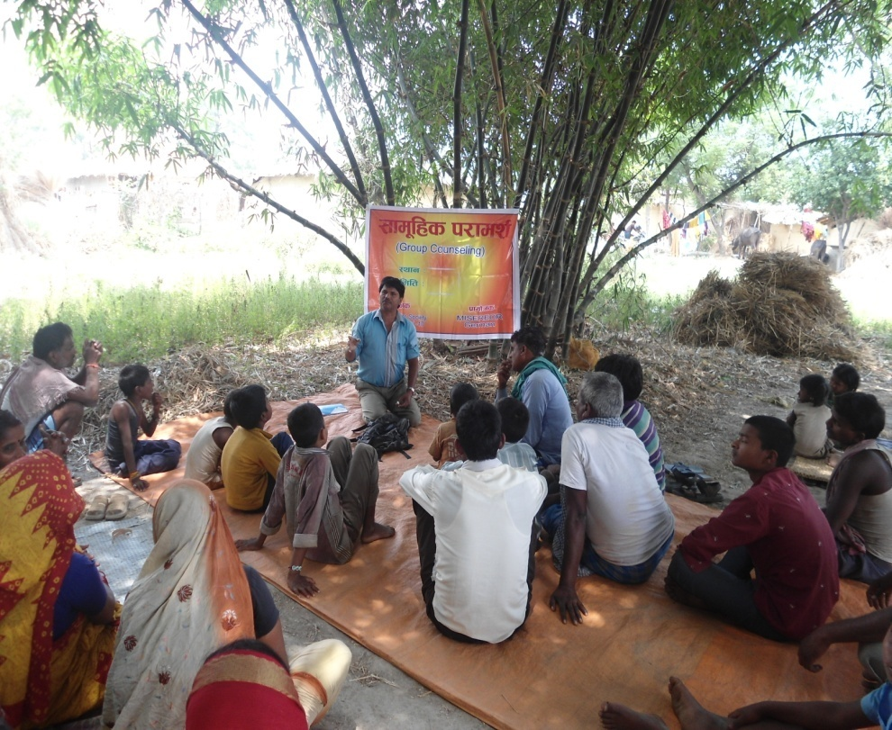
Care and Support for HIV infected People, Birgunj…………
Awareness program on HIV/AIDS in communities
Intensive focus is put on HIV/AIDS related awareness in community for creating a shared sense of urgency to tackle this epidemic.
Awareness program in communities

Slide 18
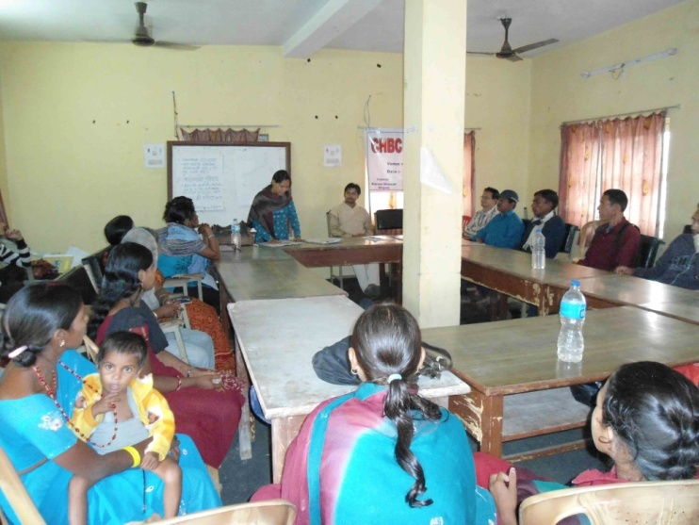
Care and Support for HIV infected People, Birgunj……
Capacity building of HIV infected people
An event of CHBC training for HIV infected people has been organized to develop an understanding of the Basic Facts on HIV and AIDS and to identify the various gaps and needs of person living with HIV and AIDS and family, and how to take the care.

Slide 19
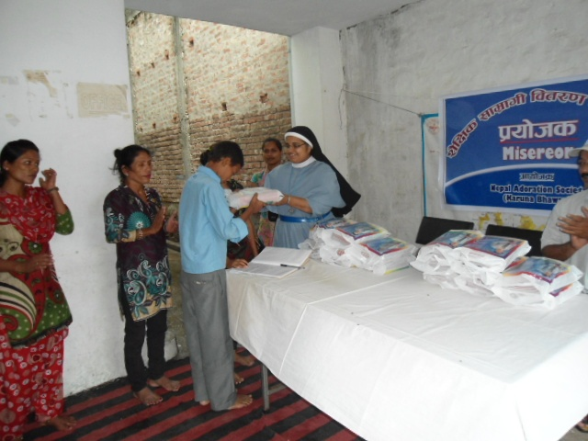
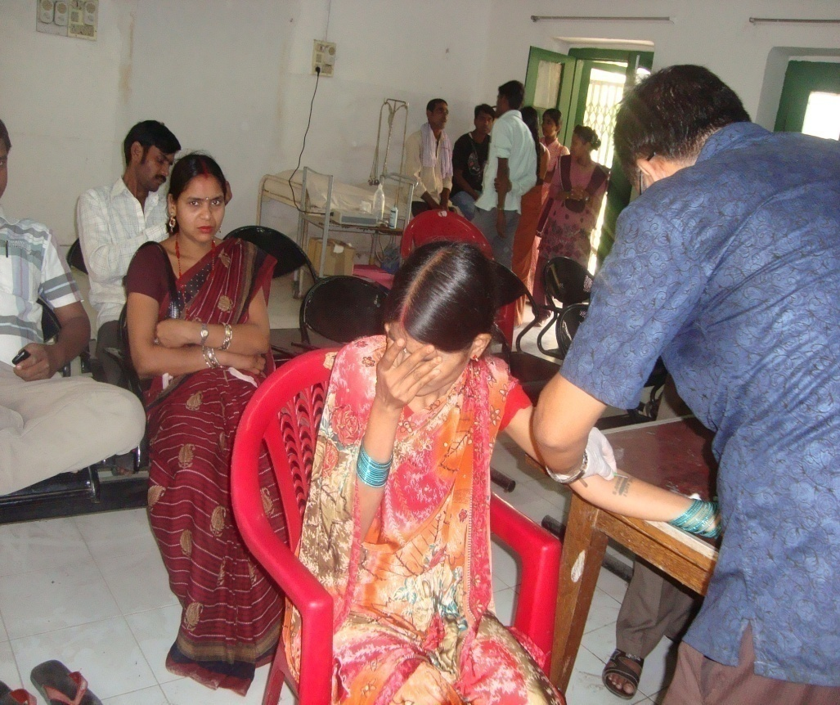
Care and Support for HIV infected People, Birgunj…………
Educational Support
Referral for CD4 count test

Slide 20
Karuna Education Support, Nakkhu
The project ‘Karuna Educational Support’ intends to improve the living conditions of the children from vulnerable and marginalized family by providing access to quality education.
Project Objectives:
Providing support for educational development of children from marginalized family.
Providing support for intellectual and psychological development of vulnerable and marginalized children.
Activities:
School fee support.
Educational Material support.
Health checkup program.
Library support.
Saving by children.
Children's day program.

Slide 21
Karuna Education Support, Nakkhu…………….
Achievements:
65 children enrolled in school .
65 children received educational materials.
65 children received school fee support .
65 children benefited by the health check up .
65 children participated in children’s day program
65 children benefited through child saving program
43 children received Library Support

Slide 22
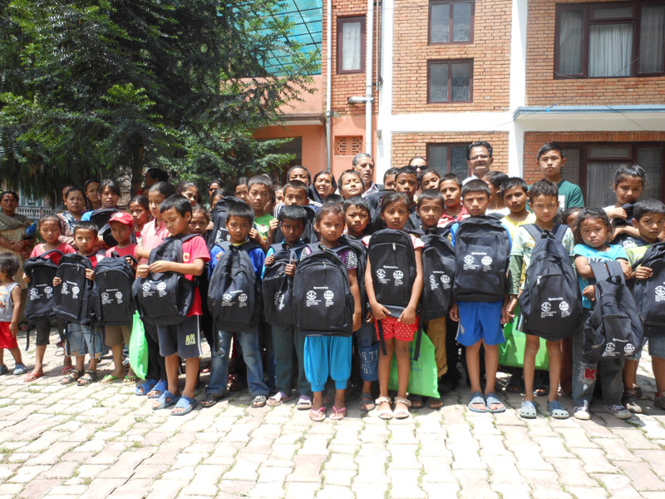
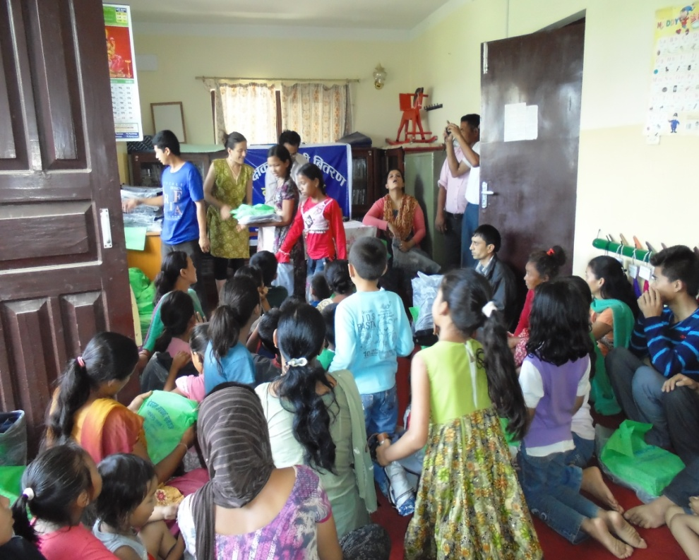
Karuna Education Support, Nakkhu…………….
Educational material support
Educational material such as copies, school bags, writing materials were distributed to beneficiary children.

Slide 23
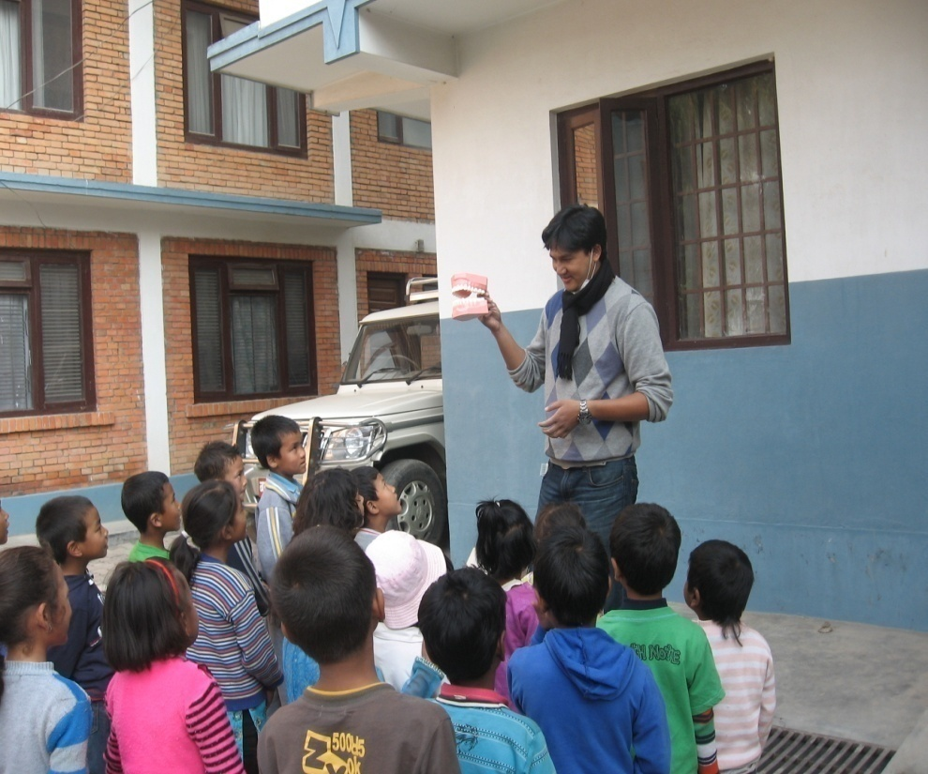
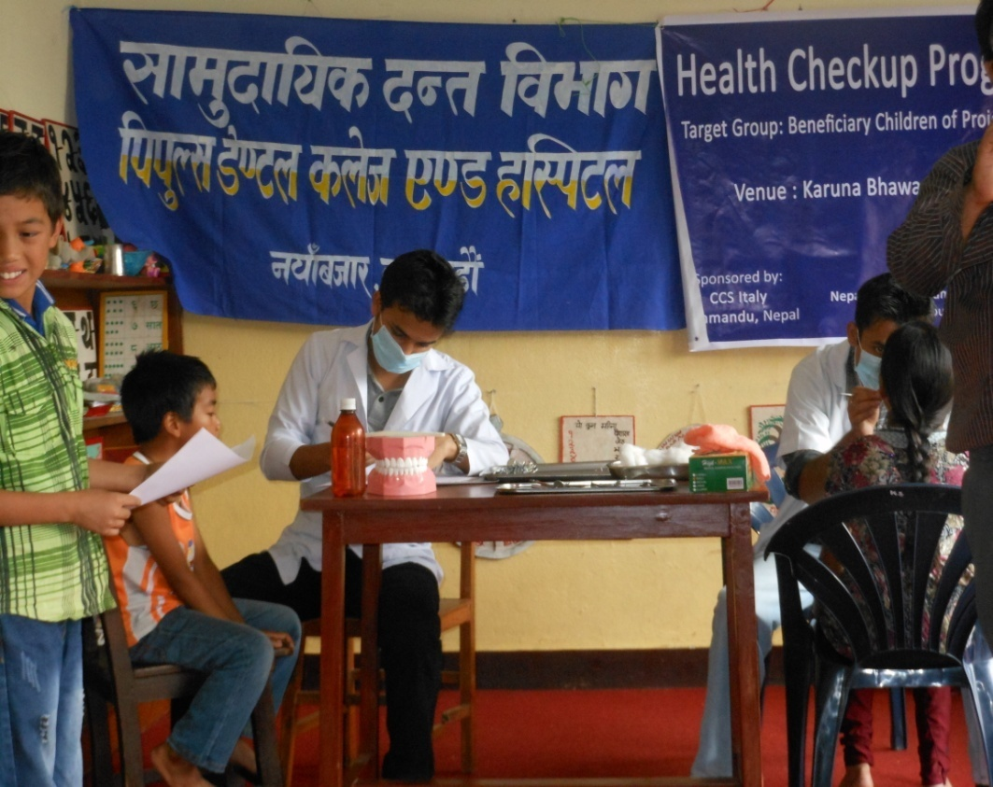
Karuna Education Support, Nakkhu…………….
Health checkup:
2 events of health check up program were organized to monitor general as well as oral health status of the beneficiary children. 65 children received the benefit.

Slide 24
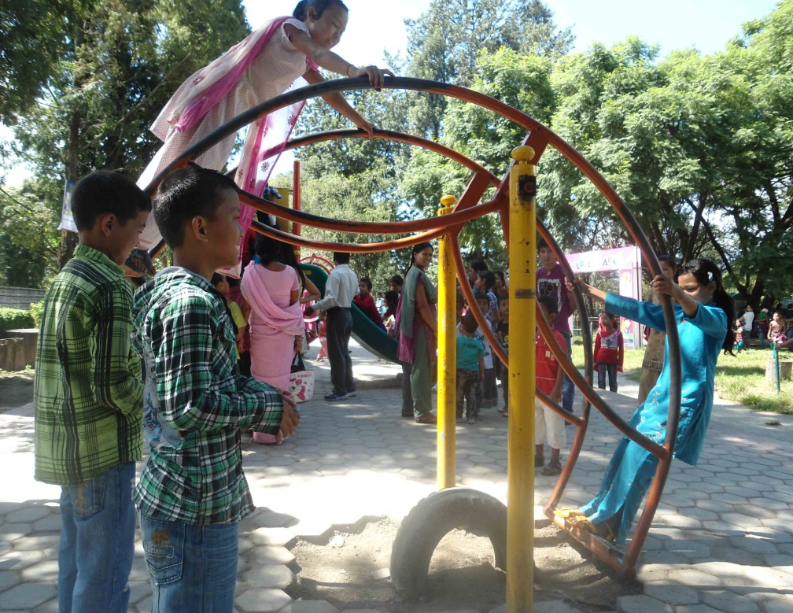
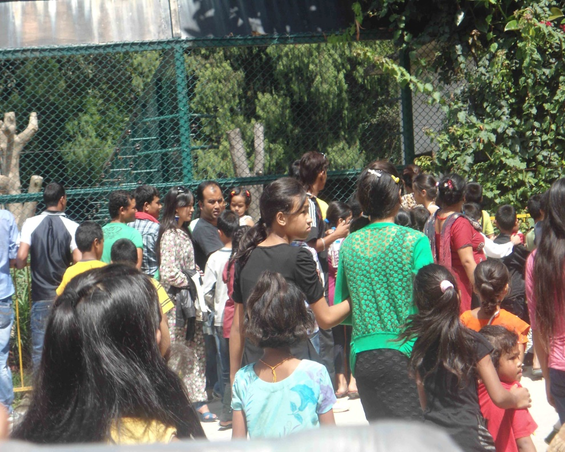
Karuna Education Support, Nakkhu…………….
Children's day:
A visit to Central Zoo, Jawalakhel was organized for the children of Karuna Bhawan with objectives to acquaint children with nature and habits of animals and to have fun and pleasure.
Children in Central zoo

Slide 25
Karuna Kinderhaus, Godavari
Nepal Aradhana Samaj in partnership with FUNECH Germany is running this project to provide shelter, food, quality education, and treatment in a secure environment for vulnerable and marginalized girls of the community who are deprived of these basic needs.
Project Objectives:
Providing support in educational development of girls deprived of proper education and environment from dalit, poor, vulnerable and marginalized family in the community.
Providing support in intellectual and psychological development.
Activities:
Residential and living support.
Education support.
Treatment and other essential health services.
Programs to develop intellectual, psychological traits and leadership quality.

Slide 26
Karuna Kinderhaus, Godavari………………
Achievements:
38 children received residential and living support.
38 children enrolled in school .
38 children educational support .
100% class promotion.
Personality developed through various skill trainings.
7 children got prizes in school level competition such as essay writing, poem writing, drawing, football and sports.

Slide 27
Karuna Kinderhaus, Godavari………………
New Admission:
13 marginalized and disadvantaged girls age ranging 5 to 12 years from different areas of Nepal were admitted this year. All are passing their life happily and getting quality education in different schools.
Academic Progress:
A 100% promotion rate was achieved by Kinderhaus children in the academic year ended by April 2013. Performance of remaining girls was satisfactory. Children who stood 1st in final examination of 2069B.S. were given prizes by Funech Nepal.
Games and extra activities
Besides study, girls actively take part in games and other activities. 1 girl won 3rd prize in essay writing, 2 girls won 1st and 3rd prize in drawing competition, 2 girls won prizes in poem writing and 1 each in football and sports.

Slide 28
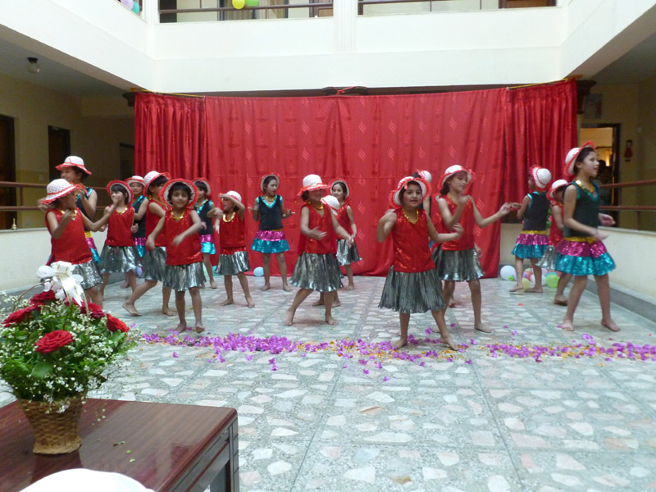
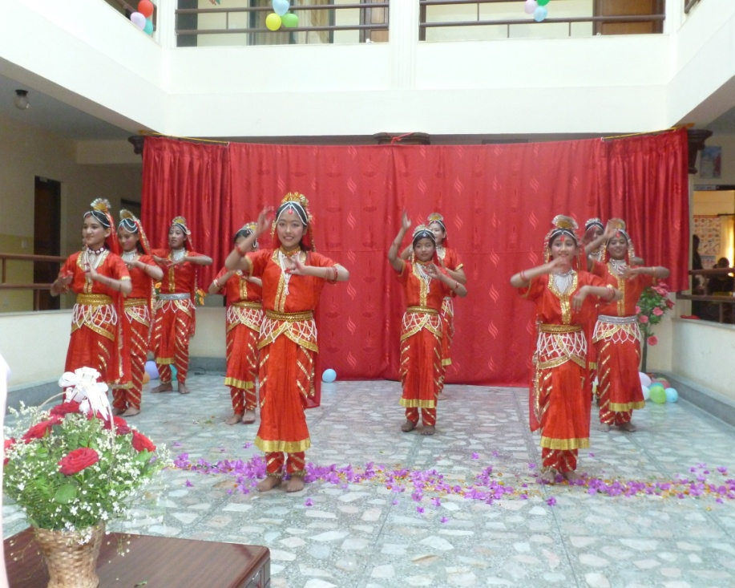
Karuna Kinderhaus, Godavari………………
Cultural program:
Children organized cultural programs on the occasion of Teej festival, children’s day and Hostel day. On each occasion they presented colourful shows packed with entertainment. They were cheered by audience on each act presented. Such cultural activities help in developing their personalities.

Slide 29
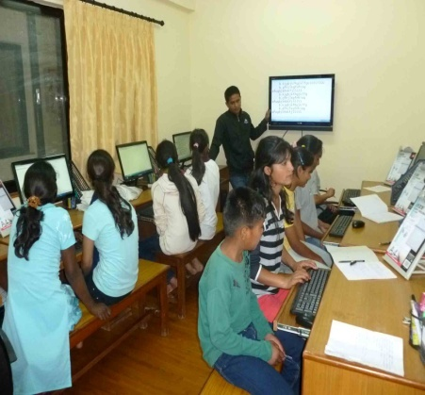
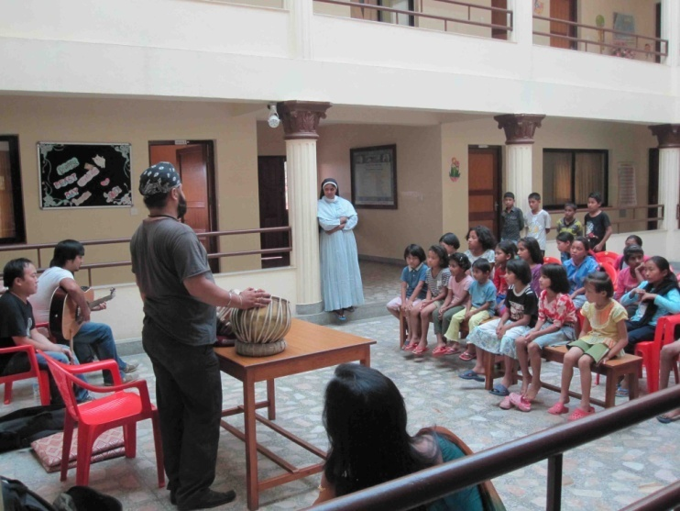
Karuna Kinderhaus, Godavari………………
Skill training:
Various trainings are provided for development of children’s skills in computer, dance, music, needle work.

Slide 30
St. Alphonsa's School, Simara
St. Alphonsa's School Simara, Bara organized by Nepal Aradhana Samaj Educational Trust got appreciation from the community for its works in the field of quality education and child development. L.K.G, U.K.G, and 1 to 4 Classes are running. There are 250 students in the school and 8 teachers are taking care of their studies. Students belong to local community and there is positive attitude among the community people towards the school.
Motto:
Education for total liberation.
Objectives:
Creating energetic, honest and generous citizen through quality education.
Develop intellectual, and leadership quality among the children.

Slide 31
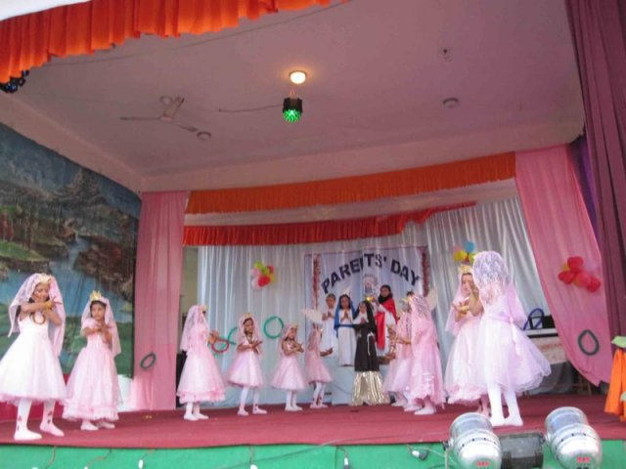
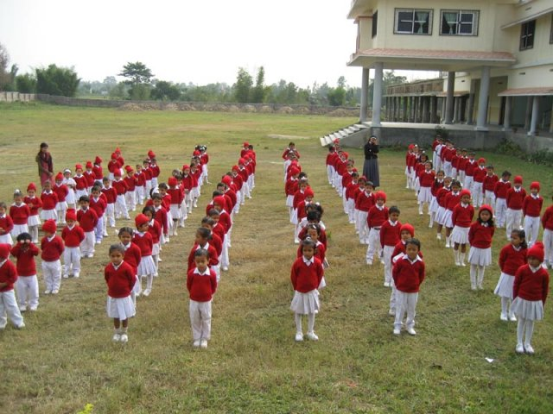
St. Alphonsa's School, Simara………
Parents’ Day program
Physical training

Slide 32
Thanks

